Slide 1
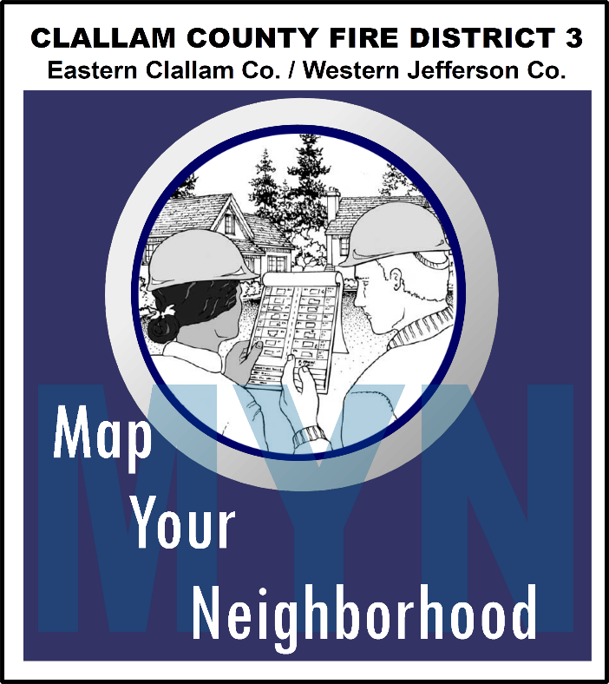
Disaster does not recognize who or what you are.
Disaster does not recognize your title, financial status, social status, age, gender,
ethnicity... After a Disaster? We are all in this together!

Slide 2
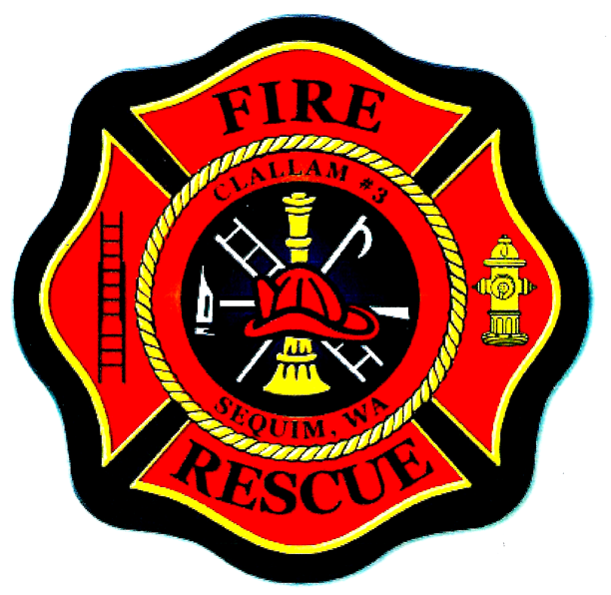
The Community Emergency Response Team (CERT) program educates volunteers about disaster preparedness for the hazards that may impact their area and trains them in basic disaster response skills, such as fire safety, light search and rescue, team organization, and disaster medical operations.
CERT offers a consistent, nationwide approach to volunteer training and organization that professional responders can rely on during disaster situations, which allows them to focus on more complex tasks. Through CERT, the capabilities to prepare for, respond to and recover from disasters is built and enhanced.
Since 1993, CERT has impacted communities across the country, building essentials skills and capabilities to prepare for and respond to any disaster. There are now CERT programs in all 50 states, including many tribal nations and U.S. territories; each unique to its community but all essential to building a Culture of Preparedness.
The CERT program was designed as a grassroots initiative and specifically structured so that the local and state program managers have the flexibility to form their programs in the way that best suits their communities. CERT volunteers are trained to respond safely, responsibly, and effectively to emergency situations, but they can also support their communities during non-emergency events as well. There are over 2,700 local CERT programs nationwide, with more than 600,000 individuals trained since CERT became a national program.
Premise:
In a disaster:
The neighbors living around you are your most immediate source of help.
Traditional 9-1-1 responders (police, fire, medical, and utility) are quickly overwhelmed by demand.
Major Goal of Map Your Neighborhood:
To prepare neighborhoods
Generally 15-20 homes in urban areas, 6-7 in rural areas
Be self-reliant during the first hours.
Objectives accomplished during a 90-minute neighborhood meeting:
1. Learn the 9 Steps to take immediately following a disaster to secure your home and protect your neighborhood.
2. Identify the skills and equipment each neighbor has that are useful in an effective disaster response.
3. Create a Neighborhood Map showing the locations of propane tanks (about 67% of house fires following disasters are caused by leaking gas); and the locations of each neighbor who may need extra help in a disaster, such as the elderly, persons with disabilities, or children who are home alone during certain times of the day.
4. Pick locations for a Neighborhood Gathering Site and Neighborhood Care Center.

